Slide 1
Boutiq travel ambassador program GA Capstone project
Johnny Huynh

Slide 2
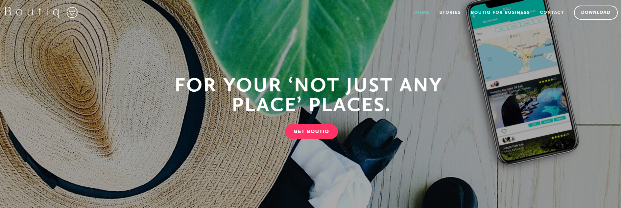
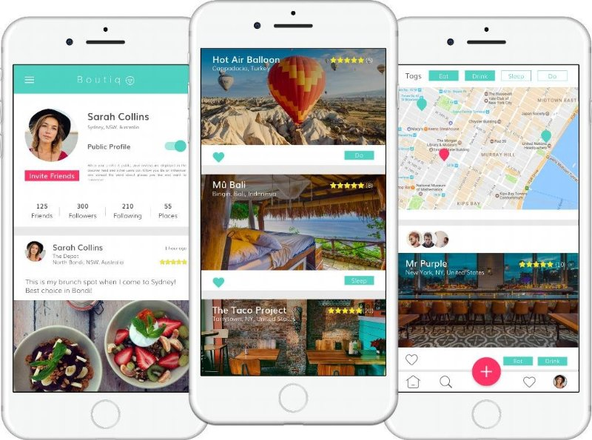
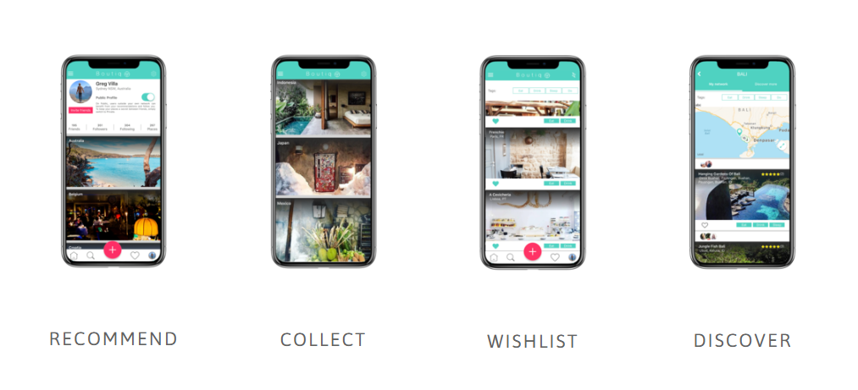
introduction
Leveraging the power of YOUR social networks
A memory bank to recommend unique places
A trip planning App, with search and quality visuals at its core

Slide 3
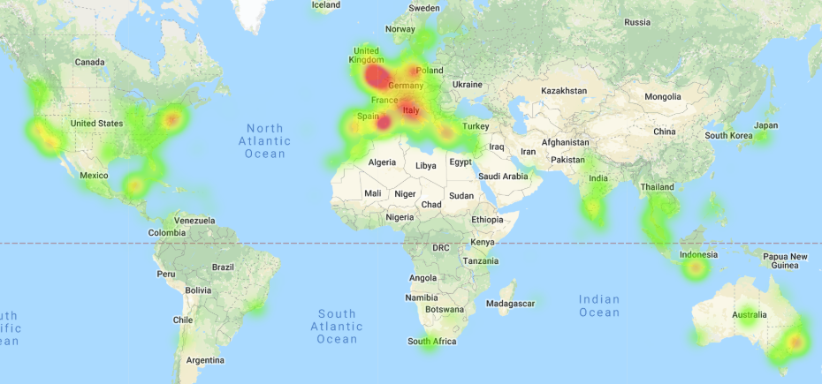
Where our users come from?

Slide 4
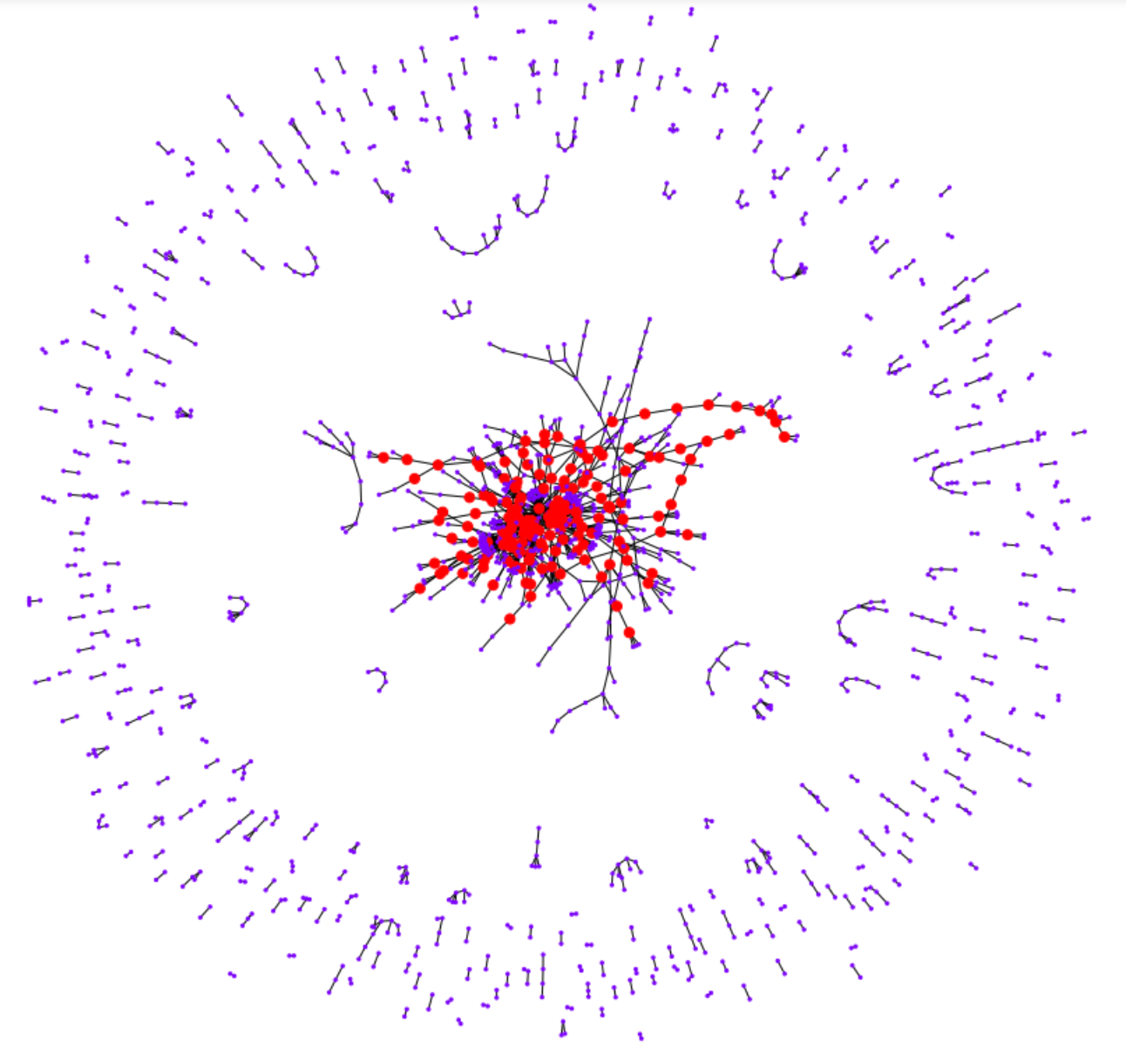
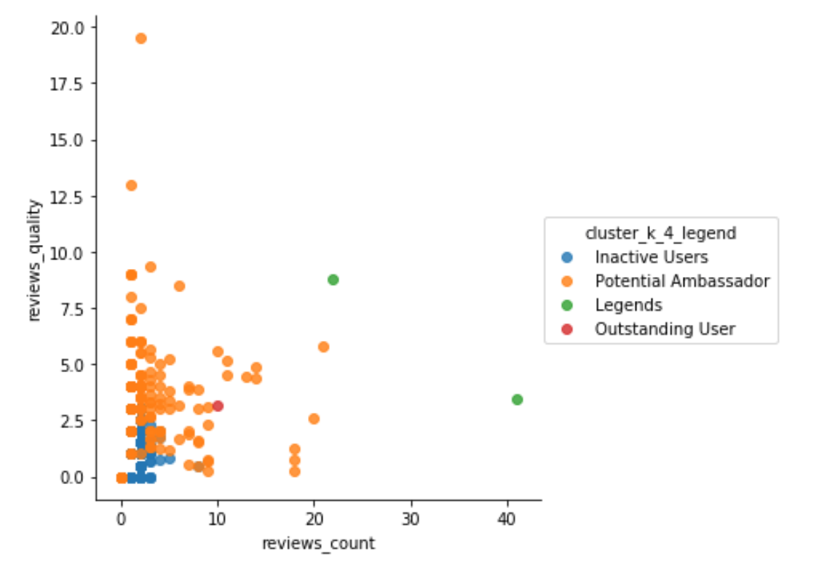
AMBASSADOR?
Goal:
Identify the most active group of users to grant them Ambassador title.
Techniques:
K-means clustering: measure the similarity of users and place them into the same group.
Social Network Analysis (SNA): identify the most ‘central’ users who act as a ‘transport hub’ where many other connections have to pass through

Slide 5

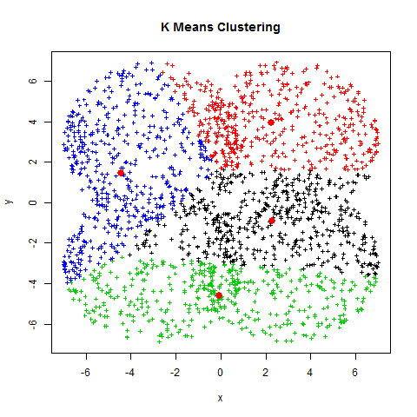
K-means clustering?
Similar users in the same group (‘cluster’)

Slide 6
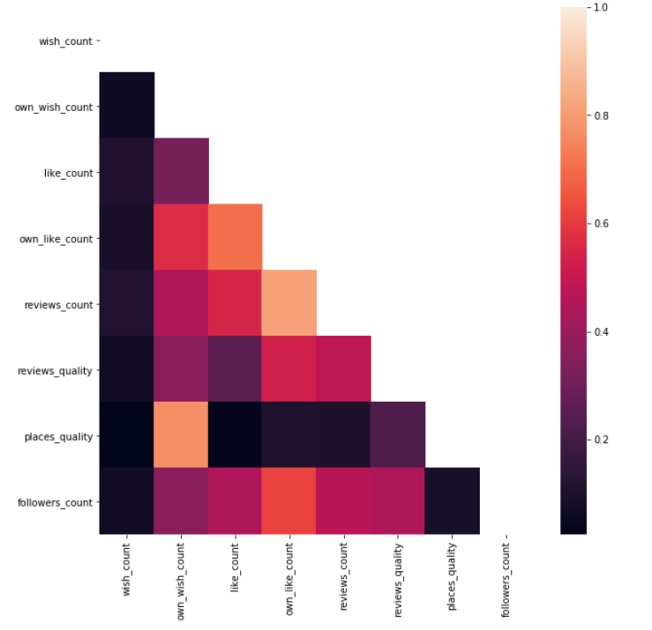
K-means clustering – FROM ID 2004
Features:
wish_count, like_count
own_wish_count, own_like_count, reviews_count, followers_count (most important)
reviews_quality, places_quality
High correlation is good because they are a
good combination to indicate the activeness.
Some highly correlated pairs:
reviews_count & own_like_count
followers_count & own_like_count
like_count & own_like_count

Slide 7
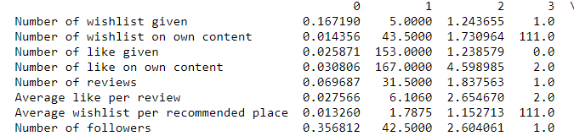
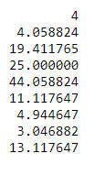
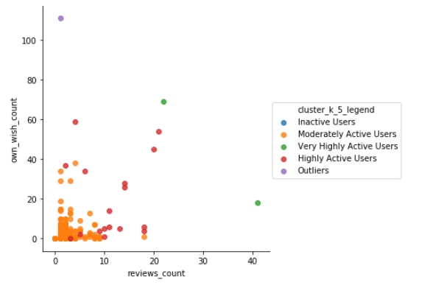
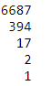

K-means clustering
5 clusters in total after try with k equals 3, 4 and 5.
Cluster centroids:
0 1 2 3 4

Slide 8
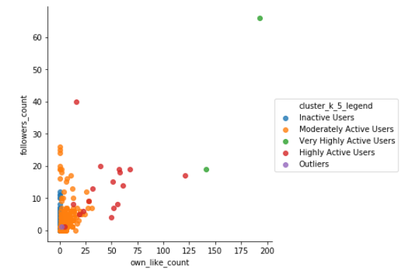
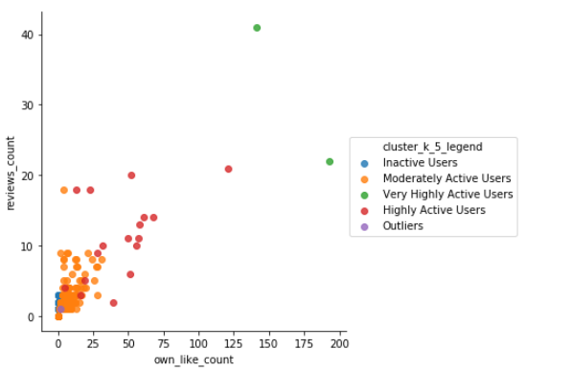
K-means clustering

Slide 9
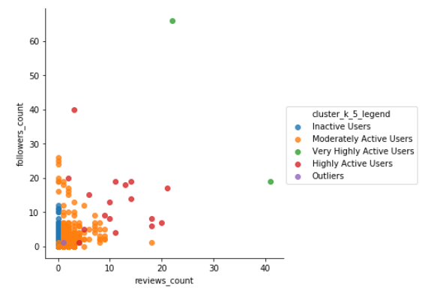
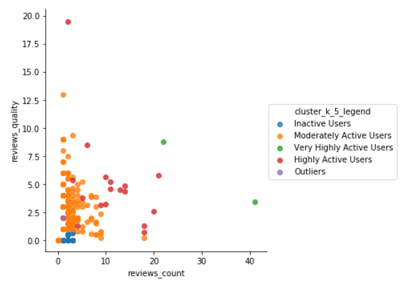
K-means clustering

Slide 10
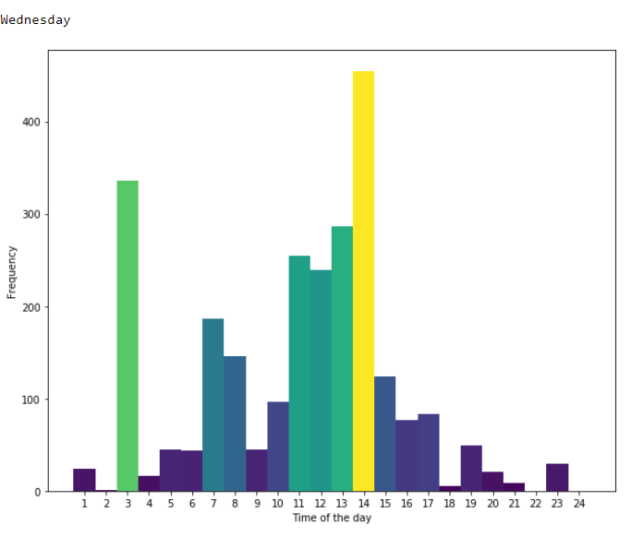
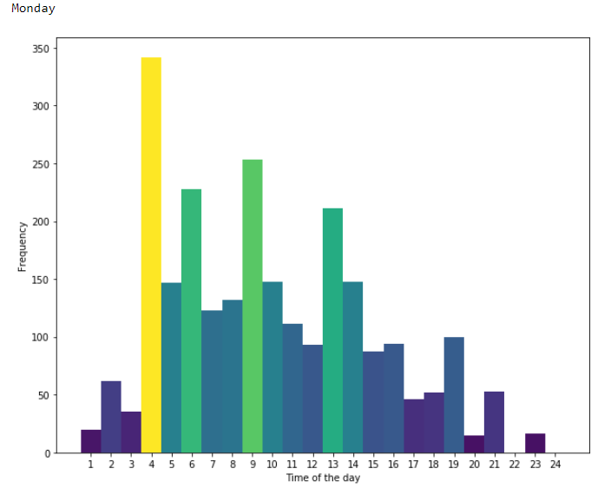
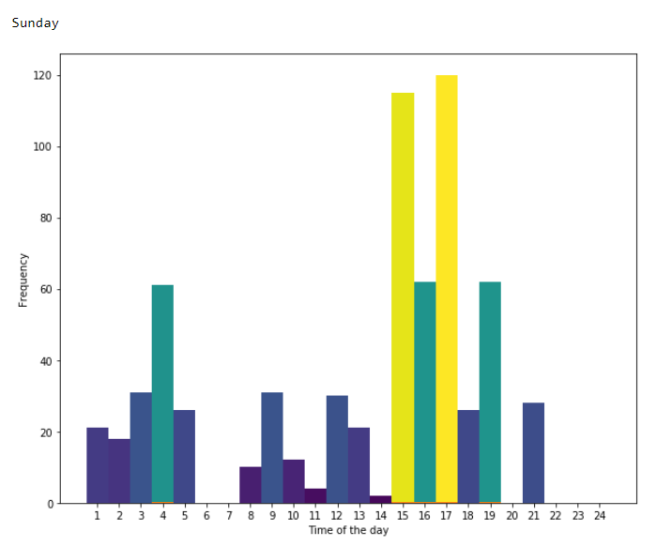
Online time of active users each weekday?

Slide 11
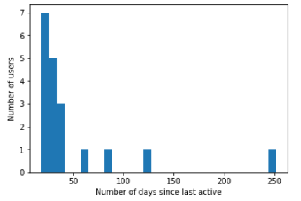
Active users in the last 100 days?
89.47% active in the last 100 days

Slide 12
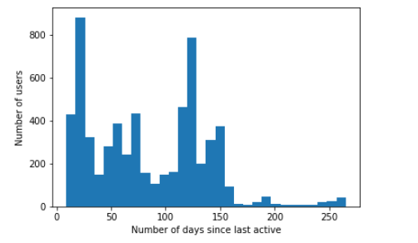
InActive users from the last 100 days?
55.15% active in the last 100 days.
Still have the opportunity to get them back!

Slide 13
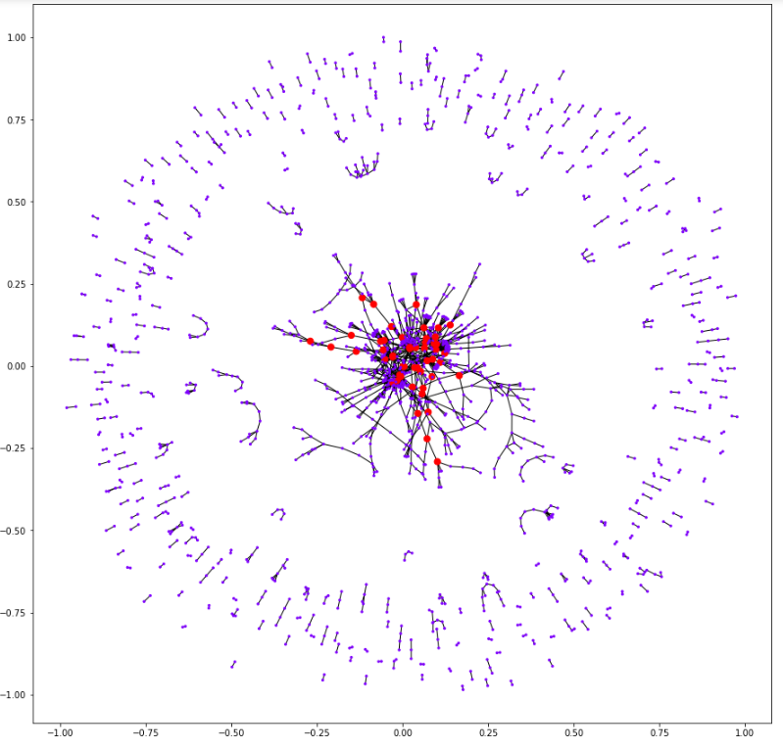
Social network analysis
14 out of 20 are in 50 most central users.
Filter out inactive users in the last 100 days.
➔ 13 best of the best candidates for Ambassador program

Slide 14
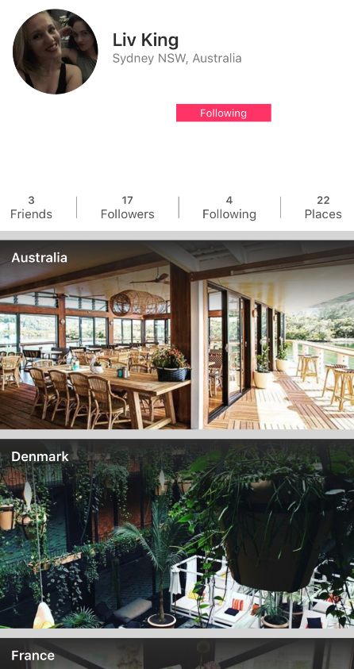
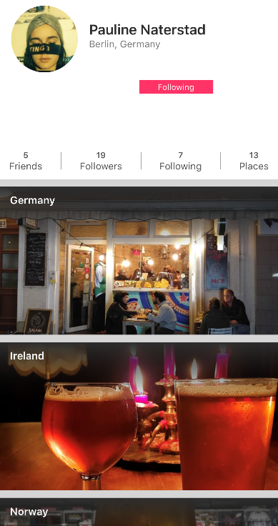
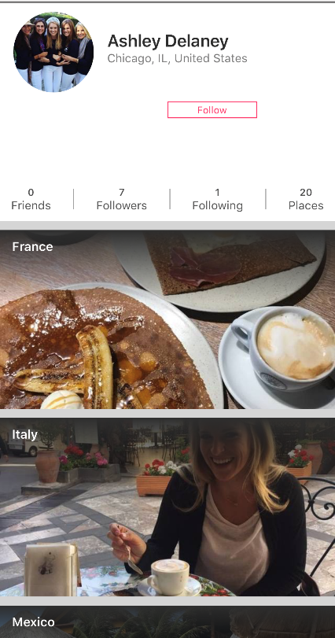
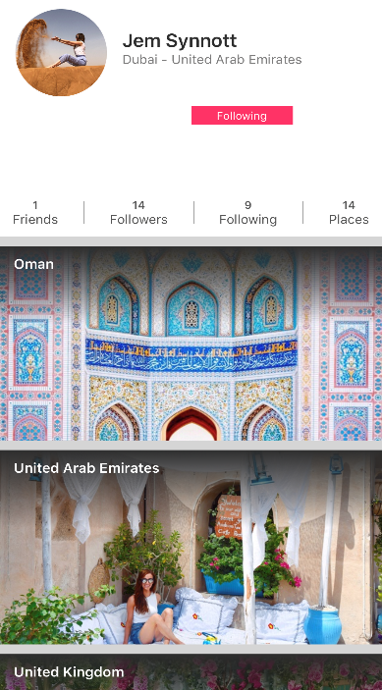
BEST OF THE BEST CANDIDATES

Slide 15
Recommendations
Combine results from K-means clustering, SNA and recent filter to select the best users for Ambassador Program.
Focus on the most active markets (Paris, UK, France, Sydney, Melbourne, San Franscisco)
Send out Promotions, Pop ups, Ambassador Request in most active hours.
Check SNA models regularly to see the interaction and connection of the community.

Slide 16
Future Works
Add the weight of relationship in Social Network Analysis (follower v.s. following)
Study the inactive group more to develop a different strategy for them?
Investigate what made a user clicks like/ wish list a review/ place ➔ Better recommender systems for greater users' interaction.

Slide 17


